Slide 1

A GIF++ Gamma Irradiation Facility at the SPS H4 Beam Line
Proposal to the SPSC
CERN, September 29th 2009
CERN-SPSC-2009-029 / SPSC-P-339
http://cdsweb.cern.ch/record/1207380
Mar Capeans, Richard Fortin, Lucie Linssen,
Michael Moll, Christoph Rembser
On behalf of the GIF and GIF++ User Communities*

Slide 2
GIF and GIF++ User Communities
Communities well known but there is no formal organisation beyond a mailing list and meetings related to the GIF/GIF++ usage/planning.
GIF users have provided in-kind contributions to the GIF facility.
GIF++ group very similar to GIF group but includes, in addition, new experiments, collaborations and groups developing equipment for sLHC.
  ALICE, ATLAS, CMS, LHCb, COMPASS, NA62 experiments
  LHC Beam loss monitors
  RD-50 and RD-51 Collaborations
  CERN PH-DT, CERN PH-ESE
  CERN DG-SCI, CERN DG-SCR
  CERN EN-STI
  CERN TE-CRG
  CERN TE-MSC
  CERN BE-BI

Slide 3
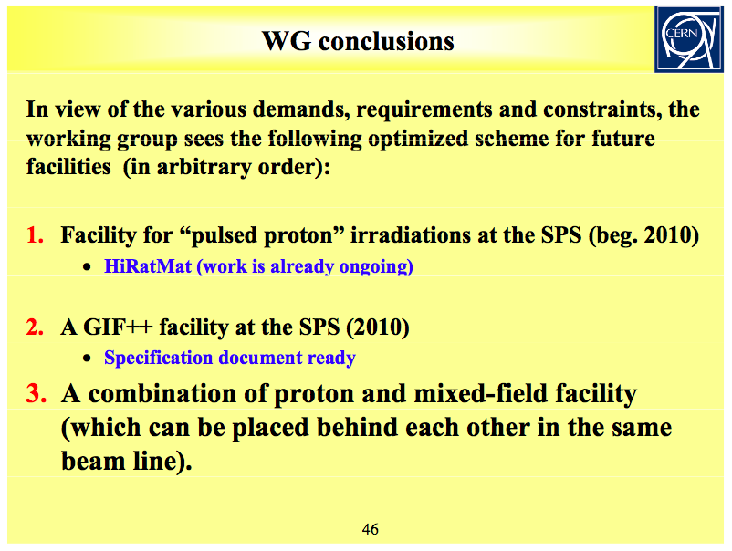
Future Irradiation Facilities at CERN
In the SPSC meeting of September 2008, H.Vincke gave a status report of the Working Group on Future Irradiation Facilities at CERN
H.Vincke, SPSC meeting, Sept 4th 2008

Slide 4
Goal of today’s presentation
Update you on the GIF++ Implementation plan.
The new GIF++ facility impacts on the use of the beam lines in EHN1 and it will include an average annual beam time request of the order of 6-8 weeks per year, as main users.
The GIF++ users are mostly involved in LHC. Yet, we think that it is appropriate to present the project to this committee rather than LHCC.
We presume that the PS-SPS Physics Coordinator will report on today's presentation and discussion to the LHCC.

Slide 5
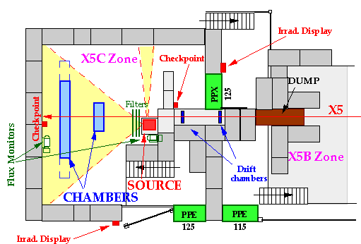
Gamma Irradiation Facility (GIF) 1997 - 2010
Irradiation Field | 740 GBq ¹³⁷Cs source irradiation (15 rad/h at a distance of 50 cm), over large surfaces (~m²), combined with SPS West area X5 beam (until 2004)
Occupation | Fully booked all year round, even nowadays (50 w/y)
Major Clients | Detector community For instance, most LHC gas detector technologies have been validated at the GIF: CMS: RPC, CSC; ATLAS: MDT, RPC, TGC, CSC; ALICE TOF, AMS; CPC, RPC; LHCb: MWPC; COMPASS detectors
Tests | Pure gamma irradiations, Long-term irradiation of detectors and performance studies under harsh background conditions (photon source= background; particle beam= signal)
Shortfalls:
Beam not available since 2004
Aged facility (source and infrastructure)
Need more photon intensity (x10)
Need more space

Slide 6
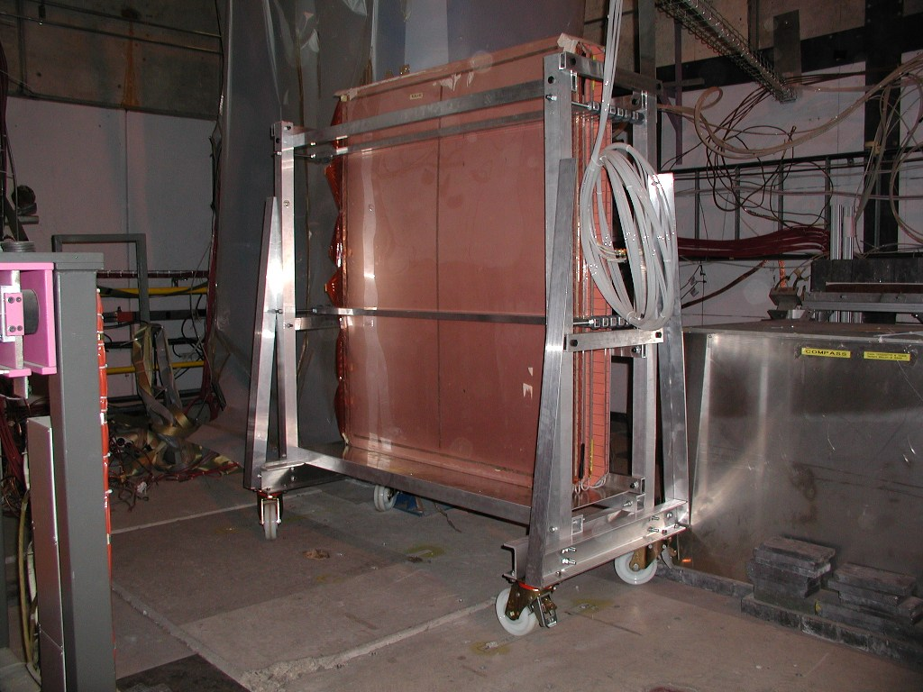
An example of Intensive Use of the GIF
Validation of CMS RPCs at GIF (R.Guida et al.)
2002 – 2004, Long-term validation tests
  Set-up 1: 11 RPC prototypes (50 x 50 cm²), Integrated charge equivalent 15 CMS years.
  Set-up 2: 3 final RPC chambers (240 x 205 cm²) operated in closed-loop gas system; Integrated charge equivalent 9 CMS years.
2008 - 2009, Optimization of RPC operation in closed-loop gas systems
    Set-up: 5 final CMS RPC chambers operated in closed-loop gas system; set-up complemented with ATLAS RPCs, test on-going.
GIF, Sept. 08
Major impact on the construction and operation of RPCs for LHC
Validation and selection of assembly materials for RPC detectors and gas systems
Optimization of the gas mixture:
  Water vapour added to the gas mixture to control the bakelite resistivity (~ rate capability).
  Gas analysis revealed fundamental for proper operation: detected impurities in the return mixture, F-production studied.
  Validation of gas purifiers for safe operation in closed-loop gas systems for LHC.
Tested detector performance with beam + photon background: efficiency, rate capability up to ~1kHz/cm², etc.
Information is shared/compared between all LHC experiments.

Slide 7
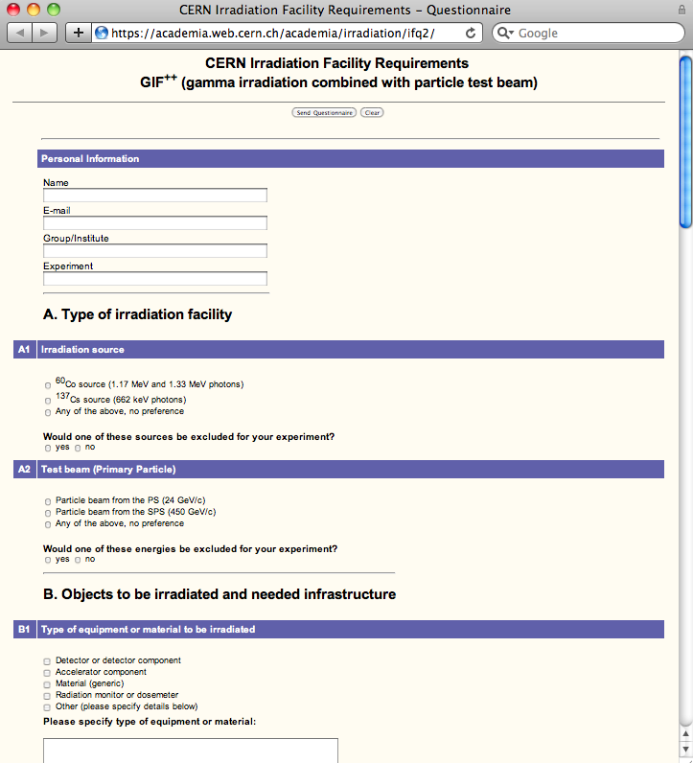
Collection of GIF++ Specifications
  Web-Questionnaires sent to users communities in particle physics.
  Questions on the required radiation field, facility infrastructure, type of irradiation experiments, annual required beam time and test time scale.
Options for Gamma Field:
  Exposure of objects to the radiation field of a high intensity gamma source
  Answers: 29
  Large-area gamma irradiation facility combined with a particle test beam of low intensity.
  Answers: 9
> In-depth discussions with the LHC upgrade program team (3 dedicated users meetings, open meetings)
Answers to Questionnaire

Slide 8
Collection of GIF++ Specifications
Two distinct communities:
There is a set of groups concerned by radiation hardness of materials, small prototype detectors, electronic components and radiation monitors or dosimetry under a strong photon flux.
Test Type, only gamma source
The second set of users represent the muon detector systems of the LHC experiments. Their focus is the characterization and understanding of the long-term behavior of large particle detectors and therefore they need, in addition to the high-rate, large-area photon background, the availability of a high energy (SPS), low rate and narrow muon beam.
A common point made by all users is the need of well equipped facility providing an excellent general infrastructure and a variety of common services to minimize administrative and setting up procedures.
The new facility is planned to be able to serve simultaneously the needs of these two communities.

Slide 9
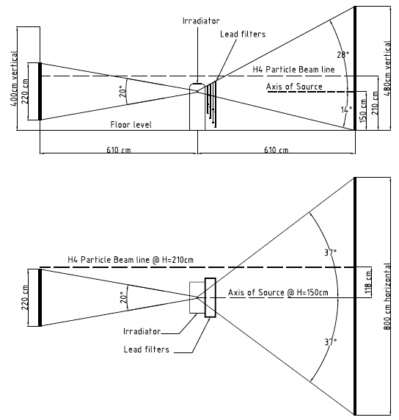
GIF++ Specifications
Source
  ¹³⁷Cs, ~7-10 TBq
  Up to ~2 Gy/h at a distance of 50 cm
  662 keV photons
  30 y isotope half-life
Particle Beam
  EHN1 location in the SPS H4 beam
  100 GeV muons
  10⁴ particles per spill traversing 10x10 cm²
Controls & Safety
Infrastructure
Max. expected doses at sLHC | Equivalent time at GIF++ (~ 50 cm from source)
Si-trackers: ~ MGy/y | >> years
Calorimeters: ~ 20 kGy/y | < 1 year
Muon systems: ~ 0.1 Gy/y | ~ minutes
Lateral view of Source and Beam
Top view of Source and Beam

Slide 10
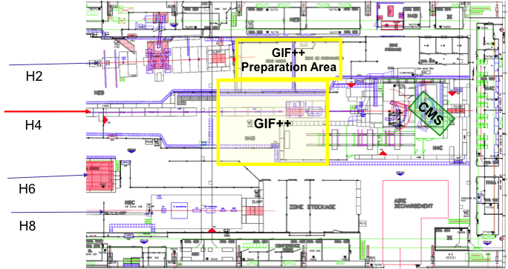
Implementation at the ENH1
Floor plan of part of the H4 beam line in the EHN1 (CERN Building 887)
Test areas are currently in operation ~ 100m upstream the GIF++ bunker: Compass-Calo, CALET, INSURAD, CMS-ECAL, CMS-BCM, NA63, RD51, LHCf, SiTRD

Slide 11
Implementation: GIF++ bunker
H4 Beam line
170 m²
GIF++ area ~ 2 x GIF area

Slide 12
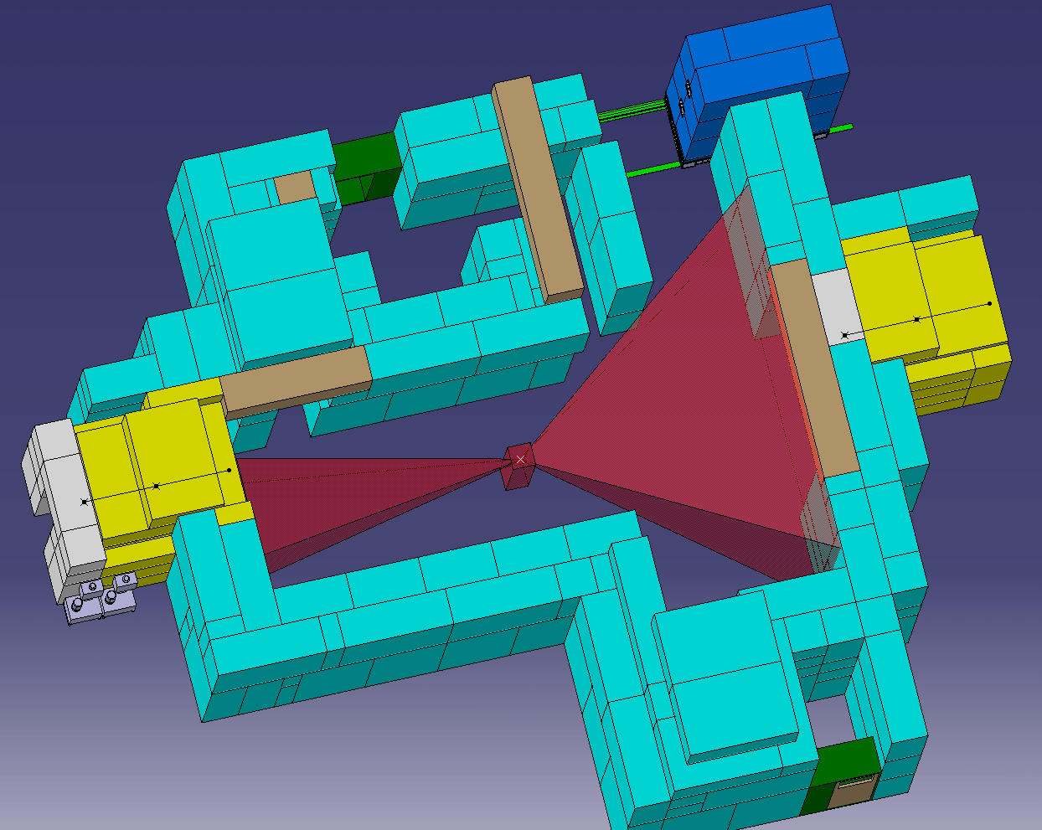
GIF++ Bunker

Slide 13
Operation Model
EN-MEF group
  Maintenance of the GIF++ beam line and corresponding equipment
  Assistance to the users for the installation and integration of their equipment under test
  Optimization of required beam conditions
  Maintenance of the fixed gas supply installations
PH-DT
  Assistance and liaison with users on a day-to-day basis
  Maintenance of the control system of the facility
  Maintenance of the gas mixing and purification plants, shared with the users
  Follow up the annual maintenance of the ¹³⁷Cs source by a competent external firm
  TSO of the facility
DG-SCR group
  Monitoring of all ionizing radiation in the area in view of safety regulations
  Radiological risk assessments in view of different test conditions
Users
  Responsible for their specific detectors and peripheral equipment such as user-specific gas equipment, cables, power supplies, readout electronics, DAQ, etc.
  Data taking shifts
PS/SPS Coordinator
  Allocation of particle beam time and its sharing between GIF++ users

Slide 14
Requested Beam Time
Completion of the GIF++ installation by mid-2010
GIF++ Commissioning
  Running-in time of approximately 8 weeks; this includes 2 weeks with secondary SPS beam of modest intensity.
Annual running of 48 weeks with the gamma source
Beam time as a main H4 user, of 6 to 8 weeks spread over three ~2-week periods.
  Muon beams at energies above 100 GeV, complemented occasionally with charged pions, protons and electrons.

Slide 15
Conclusions
We propose the implementation of a new gamma irradiation facility, combined with a high-energy particle beam in the SPS H4 beam line in hall EHN1.
  GIF++ is motivated by strong needs from the LHC and sLHC detector and accelerator communities.
  GIF++ follows up on the very successful GIF facility in the SPS west area, which lost its access to a particle beam in 2004 and which currently suffers from a lack of sufficient source intensity.
  The GIF++ facility presented takes into account the requirements from the users and has been discussed extensively with them.
We ask the SPSC committee to:
  Endorse the scientific case for the new GIF++ facility and ask it to support the implementation of the facility in the H4 location
  Confirm that H4 beam time will be available for GIF++ at the level of 6-8 weeks per year after mid 2010, for a minimum period of 5y

